Slide 1

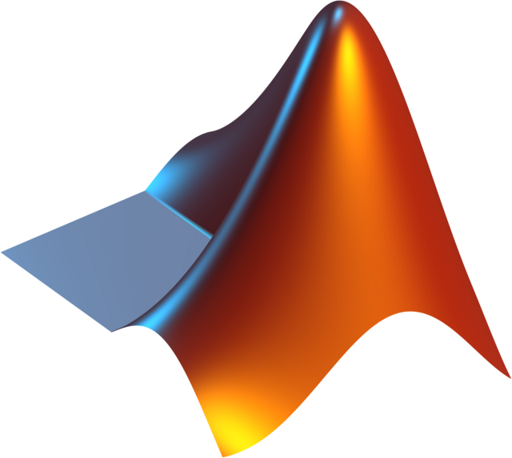

Ishan Kanodia
MODELING AND SIMULATION OF
Quadcopter using PID Controller
AUTOMATIC CONTROLS OF AIRCRAFT
PAPER PRESENTATION
NEXT SLIDE

Slide 2
Ishan Kanodia
Introduction
UAVs have seen significant advancement in recent decades, and one of the most versatile forms is the Quadcopter due to its vertical takeoff and landing capabilities.
It has been widely adopted for both military (surveillance and border patrolling) and civilian (delivery services, aerial photography) purposes.
The focus of this research is on the modeling and control of a quadcopter using a PID controller.
The main objective of this study is to stabilize the quadcopter's motion by regulating pitch, roll, and yaw using the PID controller implemented via MATLAB Simulink and Ardupilot hardware.
PAPER PRESENTATION
NEXT SLIDE

Slide 3
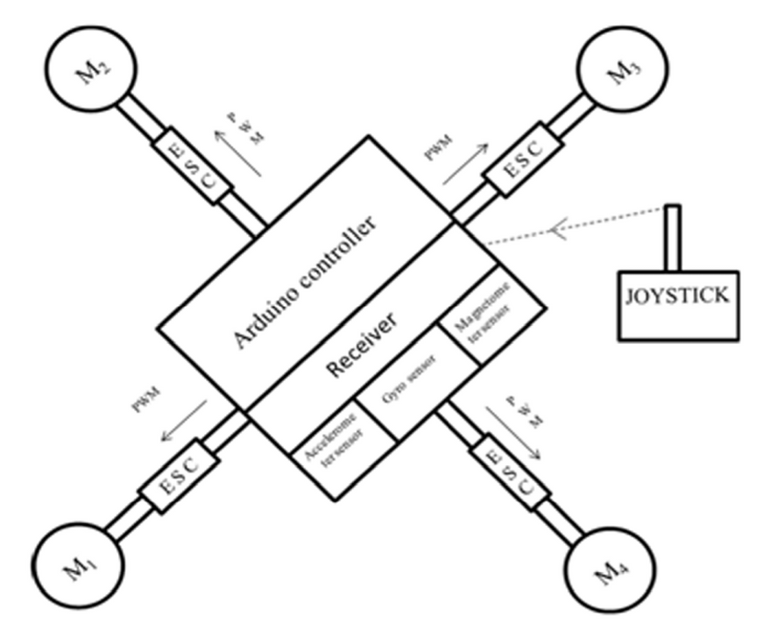
Ishan Kanodia
System Overview
A quadcopter operates using four brushless DC motors arranged in a cross configuration.
Two motors rotate clockwise and two rotate anticlockwise, generating the necessary thrust and torque to maintain balance.
PAPER PRESENTATION
NEXT SLIDE

Slide 4
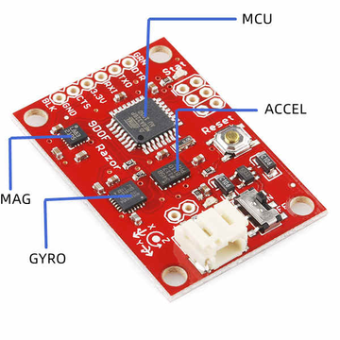
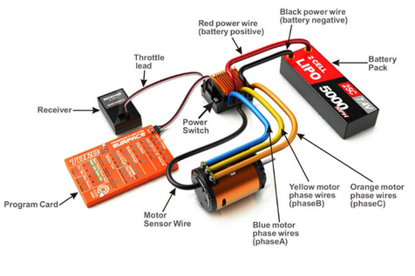
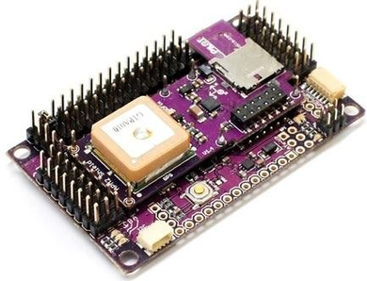
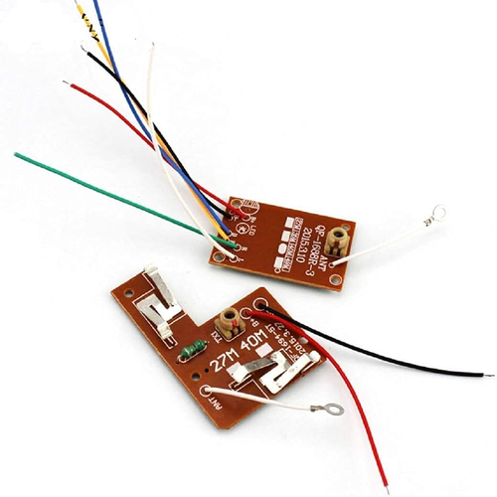
Ishan Kanodia
Components
The quadcopter system includes:
Inertial Measurement Unit (IMU): Provides orientation data using accelerometers and gyroscopes.
Electronic Speed Controllers (ESCs): Controls the speed of each motor.
Ardupilot Mega Board: Acts as the flight controller, processing inputs and sending control signals to motors.
Radio Controller and Receiver: Enables wireless communication for remote control.
The overall system aims to achieve stability during hovering, maneuvering, and altitude control using PWM signals for motor speed control.
PAPER PRESENTATION
NEXT SLIDE

Slide 5
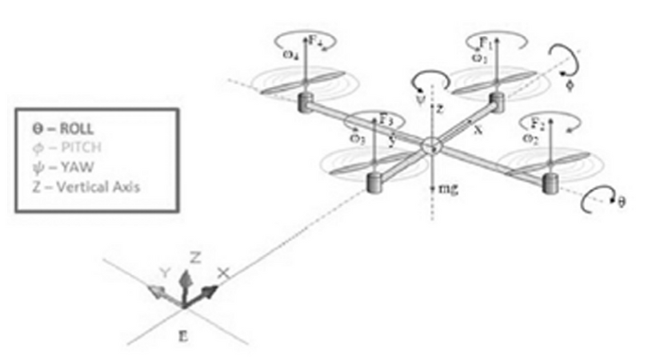
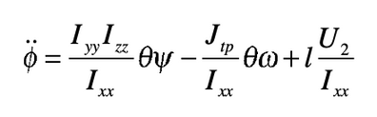
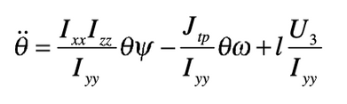
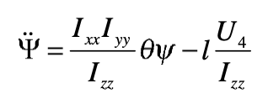
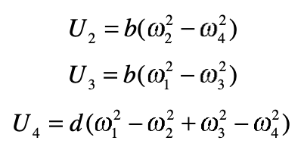
Ishan Kanodia
Modelling
Movement: Forward, backward, right, left, up, and down by controlling motor speeds
Modes: Pitch, Roll, Yaw
Stabilization: PID controller is used to maintain stable flight
PAPER PRESENTATION
NEXT SLIDE

Slide 6
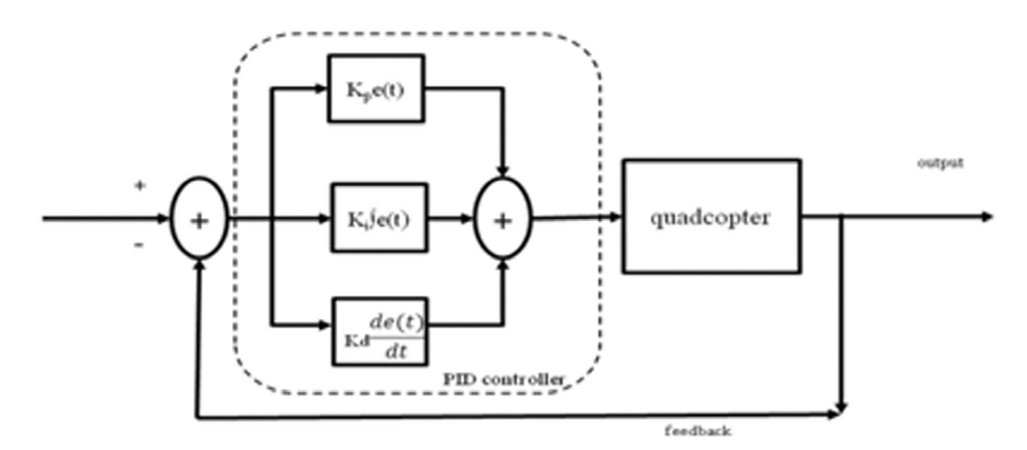
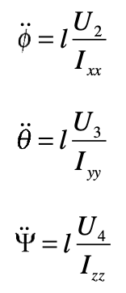
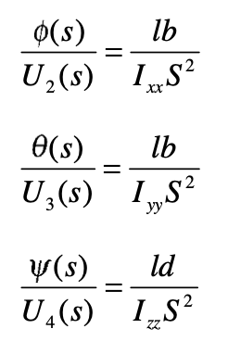
Ishan Kanodia
CONTROL STRATEGY
LAPLACE
l = Arm length
b = Thrust coeffient
d = Drag coeffient
Ixx = MOI along x-axis
Iyy = MOI along y-axis
Izz = MOI along z-axis
w = Angular velocity
Kp = Proportional gain
Ki = Integral gain
Kd = Derivative gain
e(t) = Error signal
u(t) = PID controller output
PAPER PRESENTATION
NEXT SLIDE

Slide 7
Ishan Kanodia
RESULTS
1. Software Simulation
MATLAB simulations showed stable pitch, roll, and yaw responses using the PID controller.
Pitch and roll responses were similar due to equal moments of inertia and thrust coefficients.
Yaw response differed due to the moment of inertia and drag coefficient in the z-axis.
The PID gains (P = 25, I = 0.2, D = 80) provided effective stabilization.
2. Hardware Implementation
A quadcopter prototype was built, and the PID logic was implemented.
Additional tuning was required for real-world conditions, but the quadcopter achieved stable flight and responded well to control inputs.
PAPER PRESENTATION
NEXT SLIDE

Slide 8
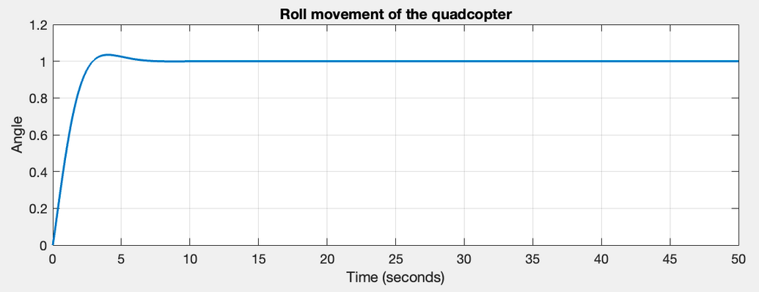
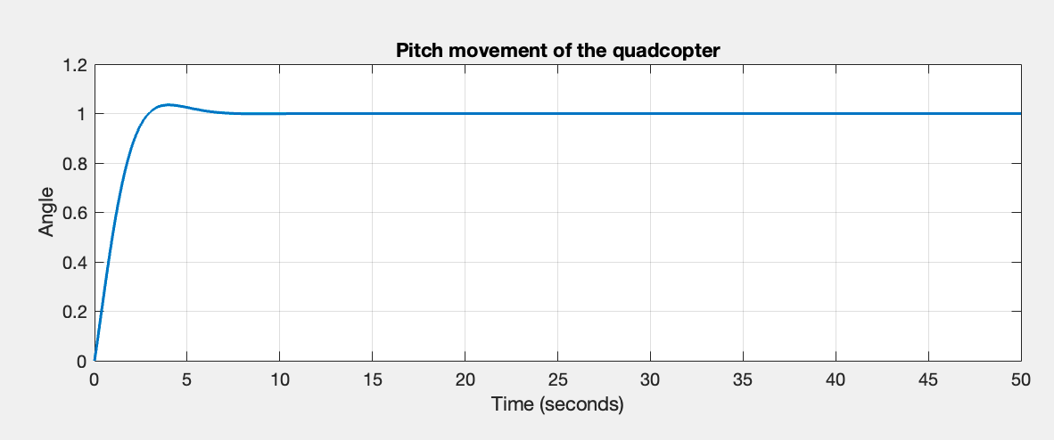
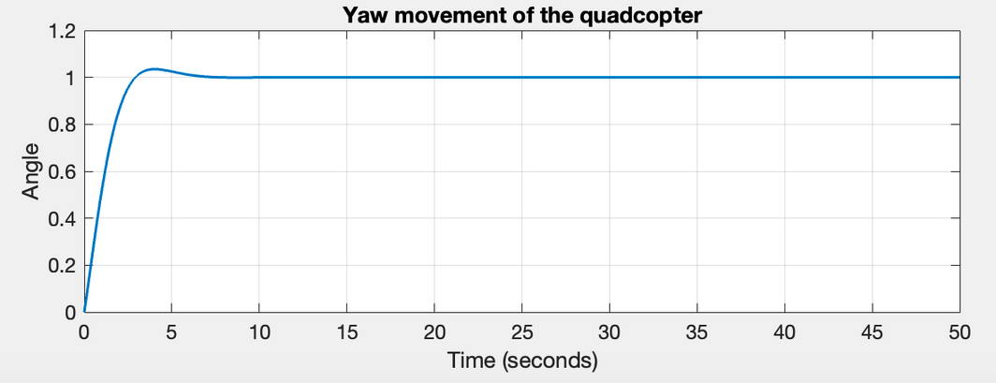
Ishan Kanodia
MATLAB
PAPER PRESENTATION
NEXT SLIDE

Slide 9
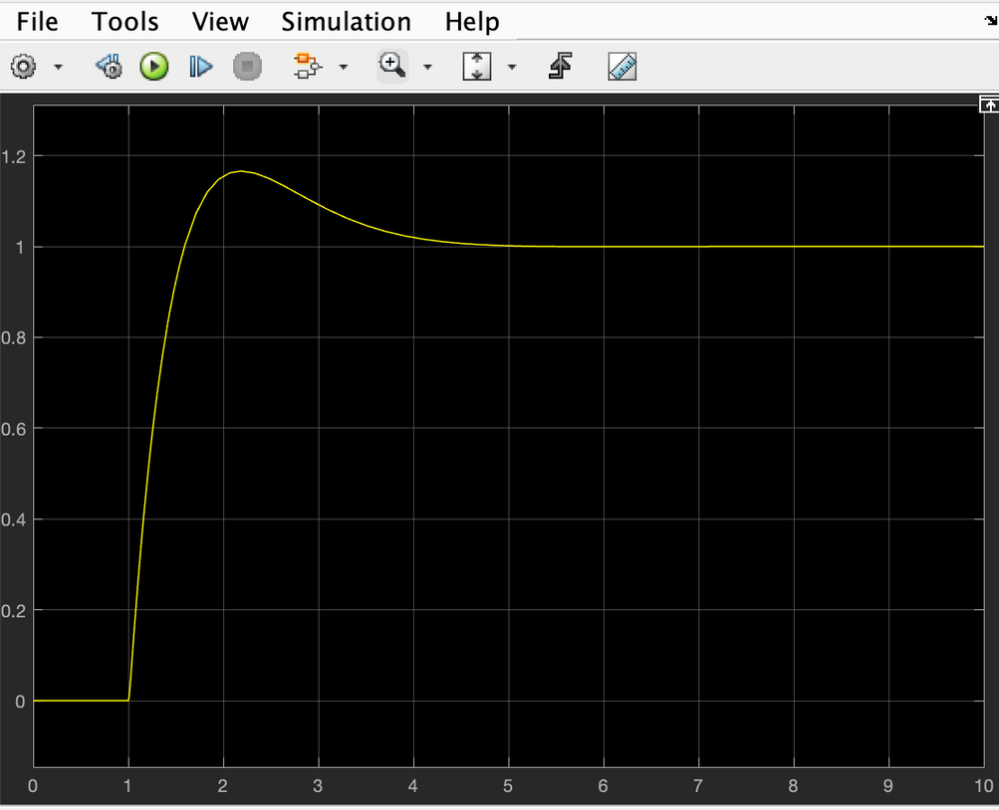
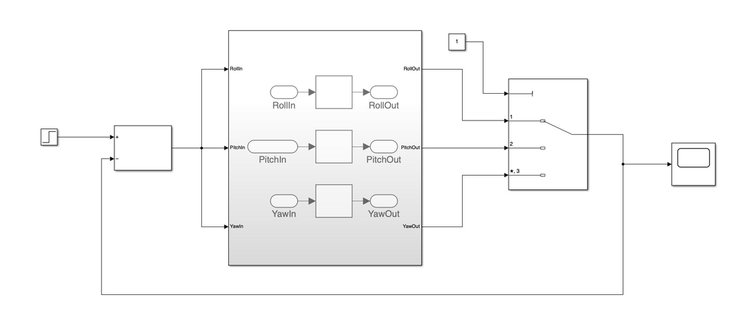
Ishan Kanodia
SIMULINK
PAPER PRESENTATION
NEXT SLIDE

Slide 10
Ishan Kanodia
CONCLUSION
In this paper, the working and implementation of pitch, roll and yaw movement of quadcopter based on
PID logic controller is presented. Mathematical modeling of quadcopter is done using MATLAB Simulink
model. For stabilization of quadcopter, PID logic controller was chosen. PID logic was implemented
successfully in MATLAB. A prototype of quadcopter is build using PID logic controller embedded on it. The working and performance of quadcopter is tested and desired outputs were obtained using PID controller.
PAPER PRESENTATION
NEXT SLIDE

Slide 11
THANK YOU
ISHAN KANODIA(22AE10014)

